Slide 1

Utd dINing System
BUAN 6320
GROUP 08
JAGDISH VISHWAKARMA
UTSAV MAISHERI
SONAKSHI HANDOO
ADITYA CHAGANTI
UCHAANSH LODHI
Data

Slide 2

Table of contents
INTRODUCTION
ER DAIGRAM
RELATIONAL SCHEMA
IMPLEMENTATION OF NOSQL
CONCLUSION
SQL DEMO
Data

Slide 3
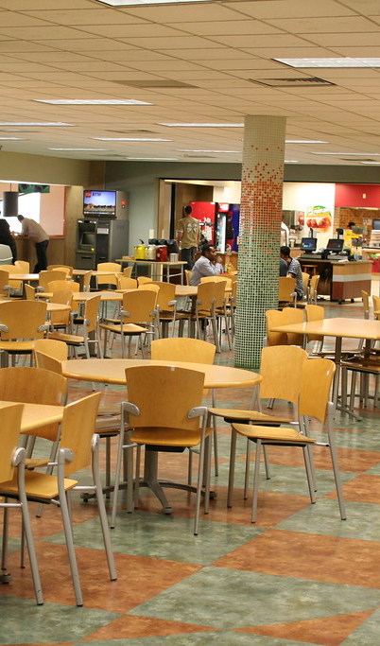
INTRODUCTION
Lack of centralized platform
The current UTD dining system lacks a centralized platform, leading to inefficiencies in meal planning, underutilization, and inadequate addressing of dietary preferences.
SQL-based Dining and Meal Plan System
Implementing a SQL-based Dining and Meal Plan System offers an opportunity to streamline meal plan management, optimize food preparation based on real-time demand, and cater to diverse dietary needs, enhancing the overall dining experience for students.

Slide 4
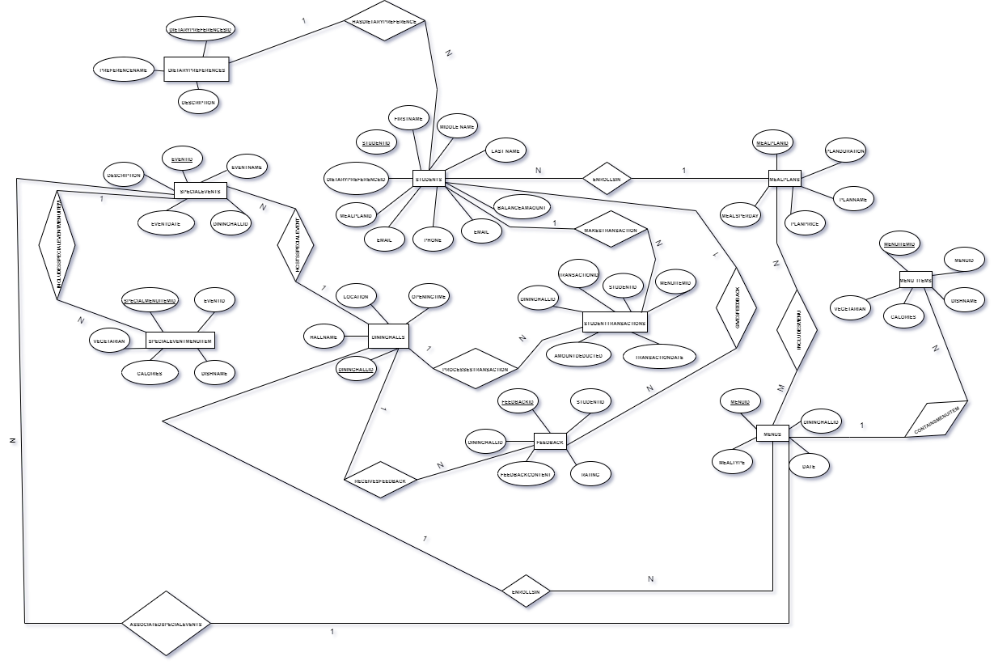
Er diagram
MealPlans
DiningHalls
DietaryPreferences
Menus
SpecialEvents
MenuItems
SpecialEventMenuItems
Students
StudentTransactions
Feedback
Data
https://app.diagrams.net/#G12149uuTS4q8384m_hZavfXBz7Pn4AXER

Slide 5
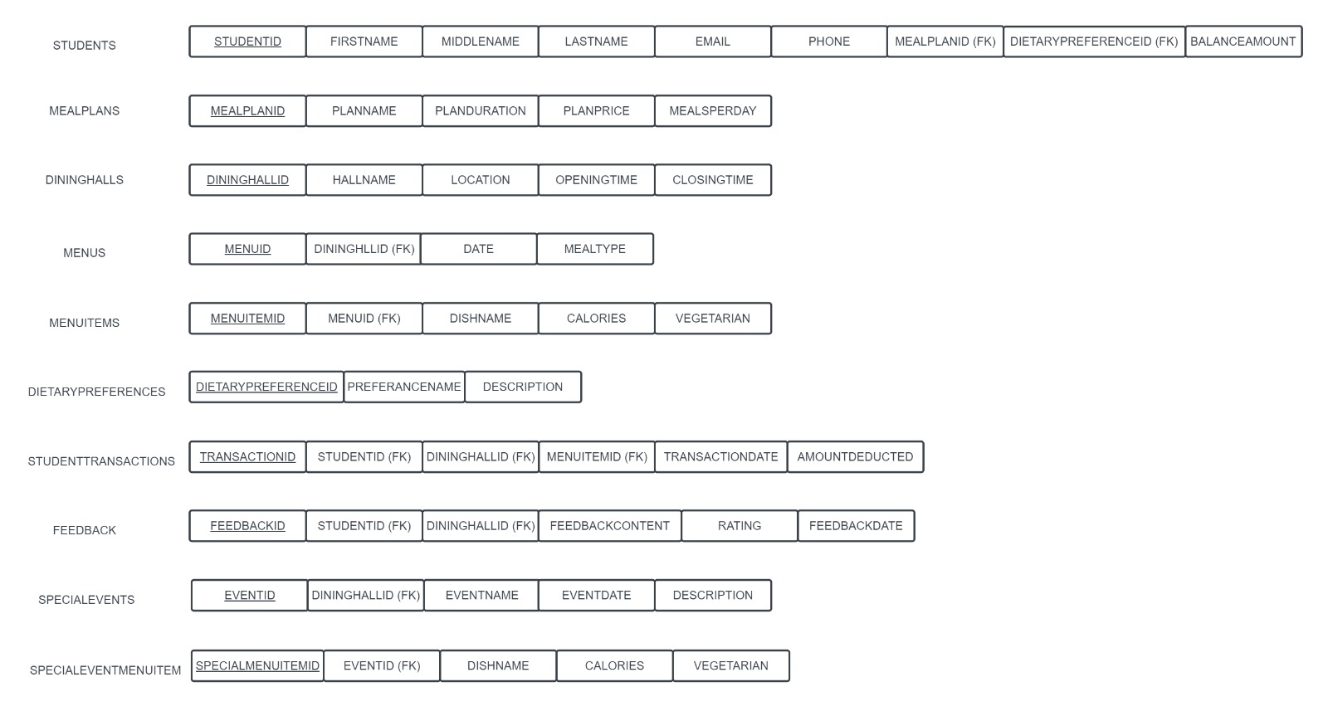
Relational
SCHEMA
Data

Slide 6
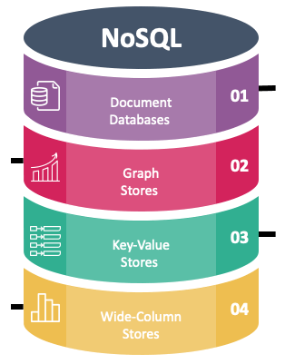
Implementation of nosql
Created the database and collection in MongoDB
Created document type data of each entity required
Adding data into collection using ‘INSERT_MANY’
Implemented python code to generate SQL Script reading JSON file
Created table for each entity in MySQL workbench to add data from NoSQL using ‘CREATE TABLE’
Inserted values in the table using the SQL script generated by python code

Slide 7
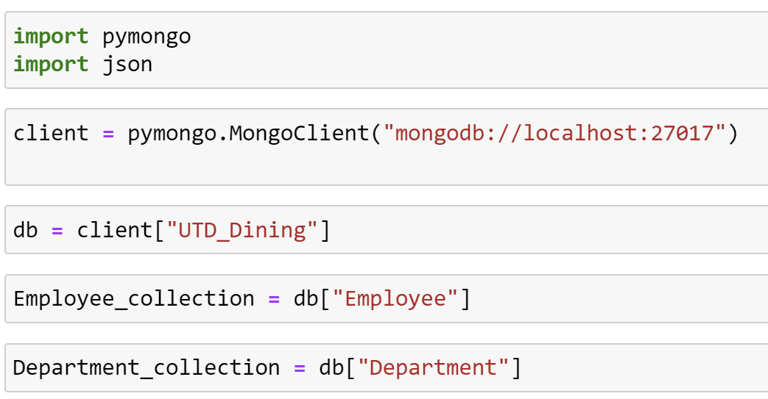
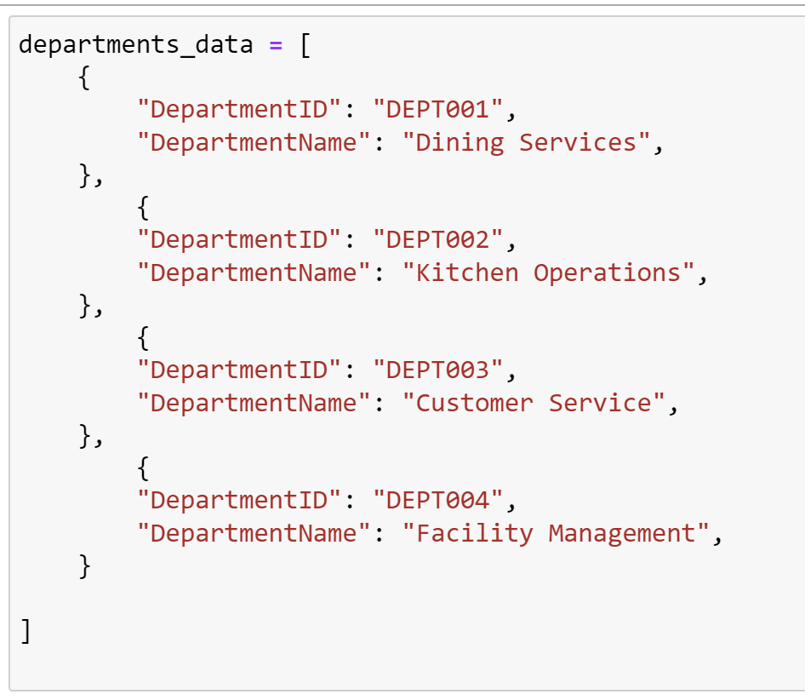
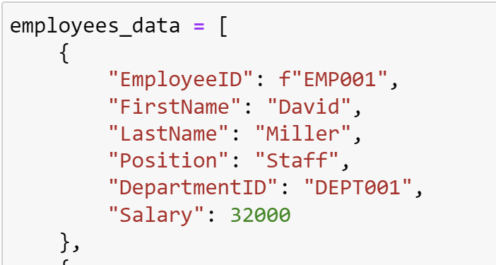
Created the database and collection in mongodb
Created document type data of each entity required
Data

Slide 8
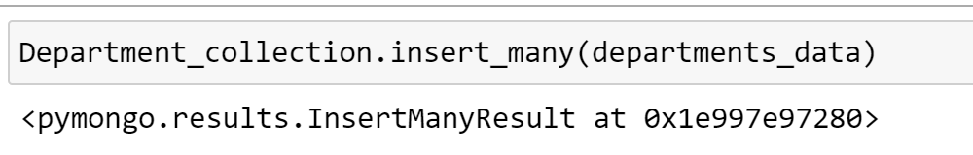
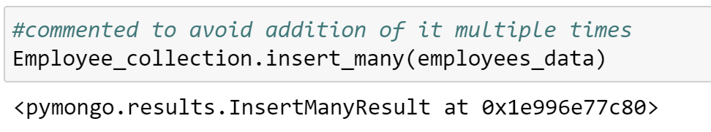
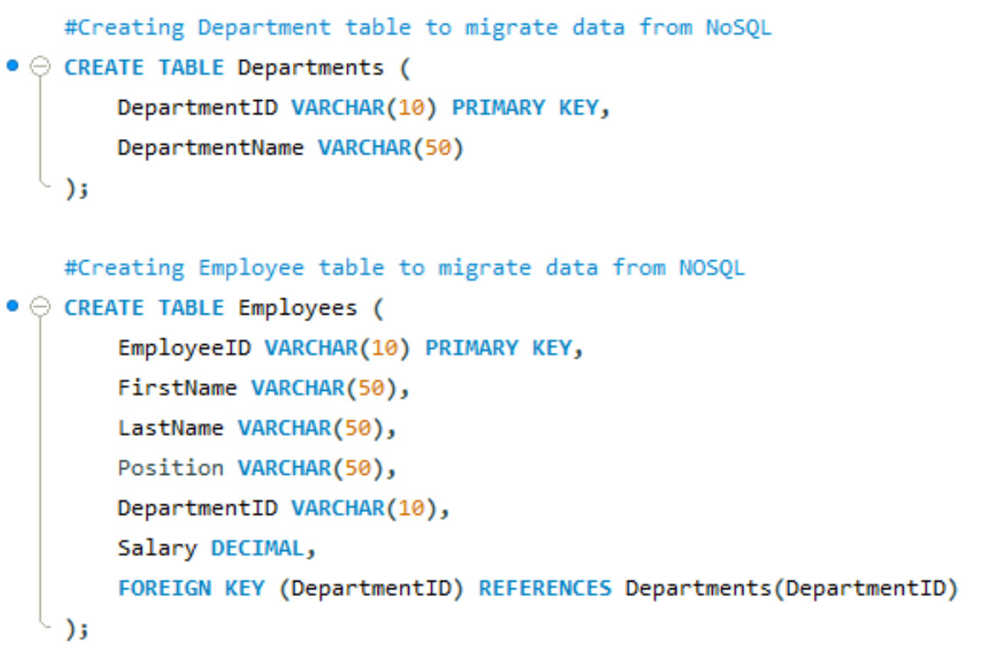
Adding data into collection using ‘INSERT_MANY’
Created table for each entity in MySQL workbench to add data from NoSQL using ‘CREATE TABLE’
Data

Slide 9
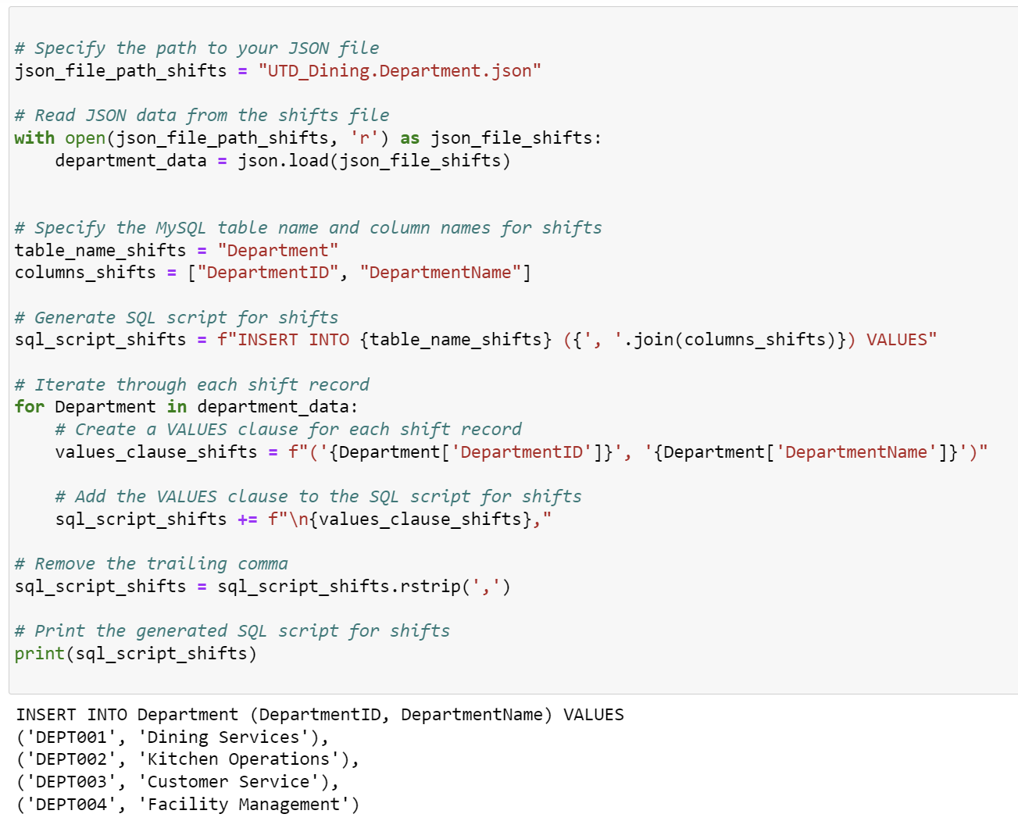
Implemented python code to generate SQL Script
Data
Inserted values in the table using the SQL script generated by python code

Slide 10


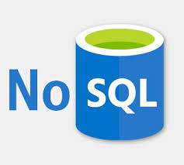

conclusion
Data
We successful implemented SQL in MySQL Workbench and NoSQL in MongoDB using Python.
Generated SQL script using Python reading JSON file.
Learned the fundamental concepts of SQL and NoSQL while successfully implementing them.

Slide 11
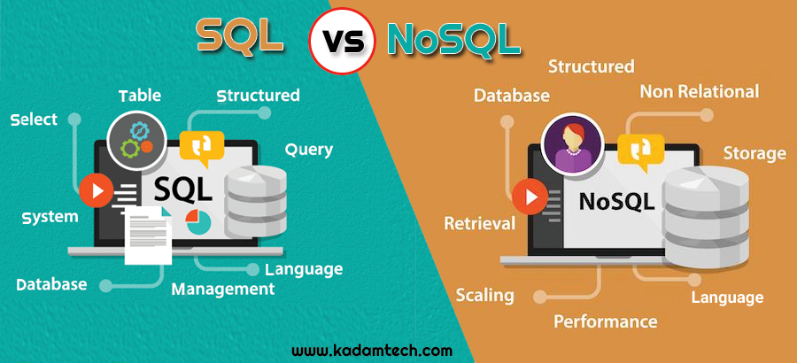
DEMO
Data

Slide 12
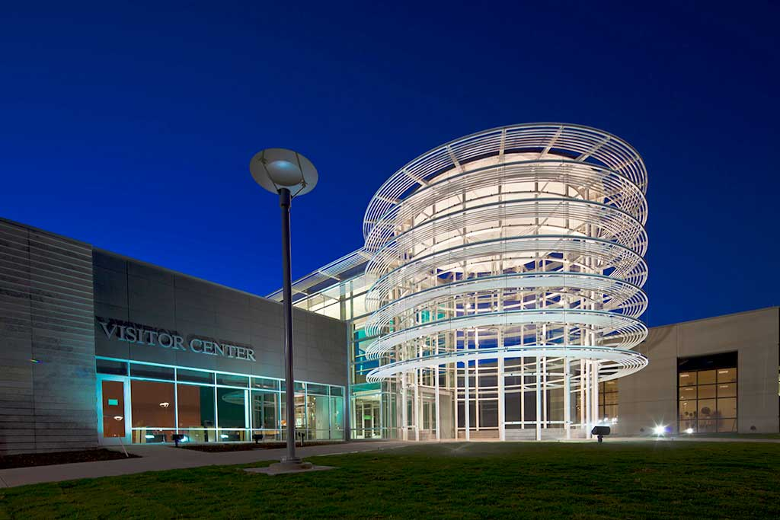
Thank You

